Slide 1
Organisation for future
Organisation for the future centre has—the following forms
1)Matrix
2) Learning
3)Network
4)Virtual
5)Boundary-less
6)Team-based
7) b2 change and alliances

Slide 2
Matrix Structure
The most complex form of org structure.
In this matrix structure one structure is superimposed on top of an existing ,but different form.
The resulting structure is quite fluid with new matrix dimensions being created, escalated, reduced or eliminated as needed.
3 features tat make matrix str distinct from other traditional ones.
1) there are mgrs. Who report to two different matrix bosses.
2) there are the matrix mgrs. Who share the subordinates.
3)there is the top mgr who expected to head the dual structure and balance and adjudicate disputes.

Slide 3
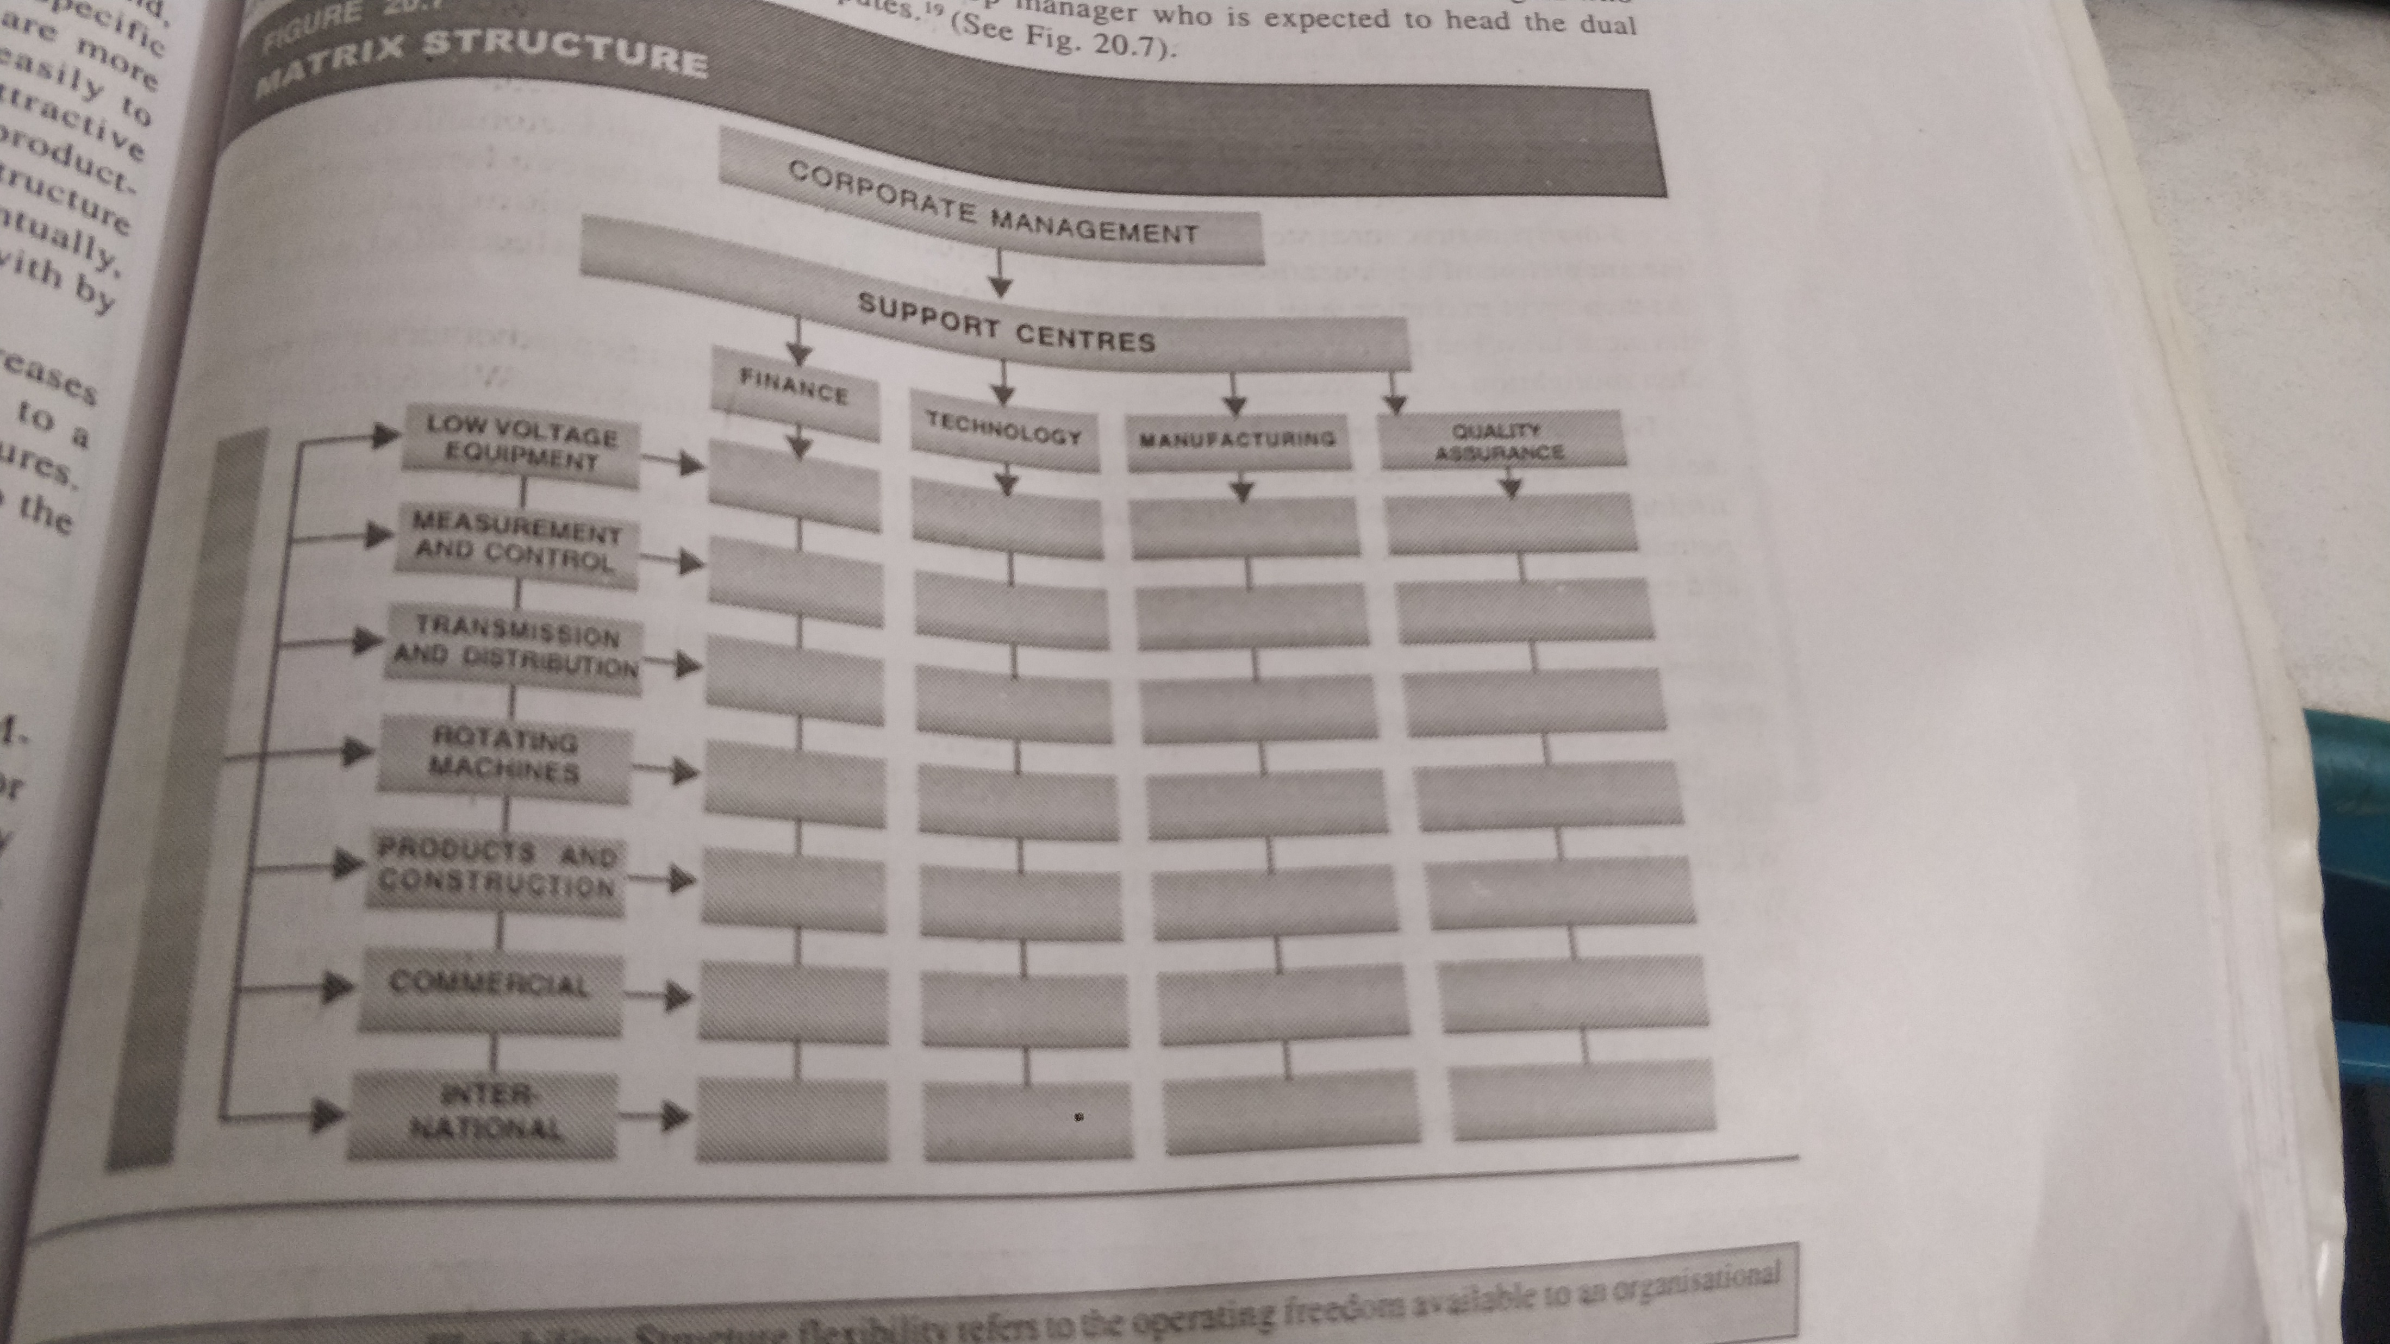

Slide 4
In the above matrix structure, functional structure is overlaid on product str.
One chain of command is exercised by functional mgrs.
This authority flows vertically
The second line of command is exercised by product mgr and it flows horizontally.
Bz the line of command flows vertically and horizontally matrix str also called “multiple command system”.

